Slide 1

Colossians

Slide 2
Colossians
Colossians Series Outline
Sept. 8 - Intro – 1:1-14
Oct. 13 – Chapter 1:15 - 29
Nov. 10 – Chapter 2:1-12
Dec. 8 – Chapter 2:13-23
2020
Jan. 12 – Chapter 3:1-17
Feb. 9 – Chapter 3:18-25
Mar. 8 – Chapter 4:1-9
Apr. 12 – Chapter 4:10-18
The Excellence and Supremacy of Messiah
The Preeminence and sufficiency of Christ in all things.

Slide 3
It is all about Jesus!!

Slide 4
Key Verse 2:9-10
“For in Him dwells all the fullness of the Godhead bodily; and you are complete in Him, who is the head of all principality and power. (NKJ)

Slide 5

False Teachings vs. The Centrality of Messiah

Slide 6
into the kingdom of the Son of His love, in whom we have redemption through His blood, the forgiveness of sins.
He is image of invisible God
He is the firstborn over all creation
By Him all things were created
  in heaven and on earth.
Visible and invisible things created by Him
thrones, dominions, principalities or powers.
All things were created though Him and for Him.
He is before all things, and in His all things consist.
He is the head of the body – the community of faith.
He is the beginning, the firstborn from the dead.
The one that in all things has preeminence.
In Him all fulness dwells.
By Him all things reconcile
on earth or in heaven….
  having made peace through His blood.
You were alienated
You enemies in your mind by wicked works
Now you are reconciled
To present you holy
If indeed you continue in the faith.
The hope of the gospel which you heard.
Paul’s suffering for you,
Grace given Paul for you.
Mystery among the Gentiles:
  Christ in YOU, the hope of glory!

Slide 7
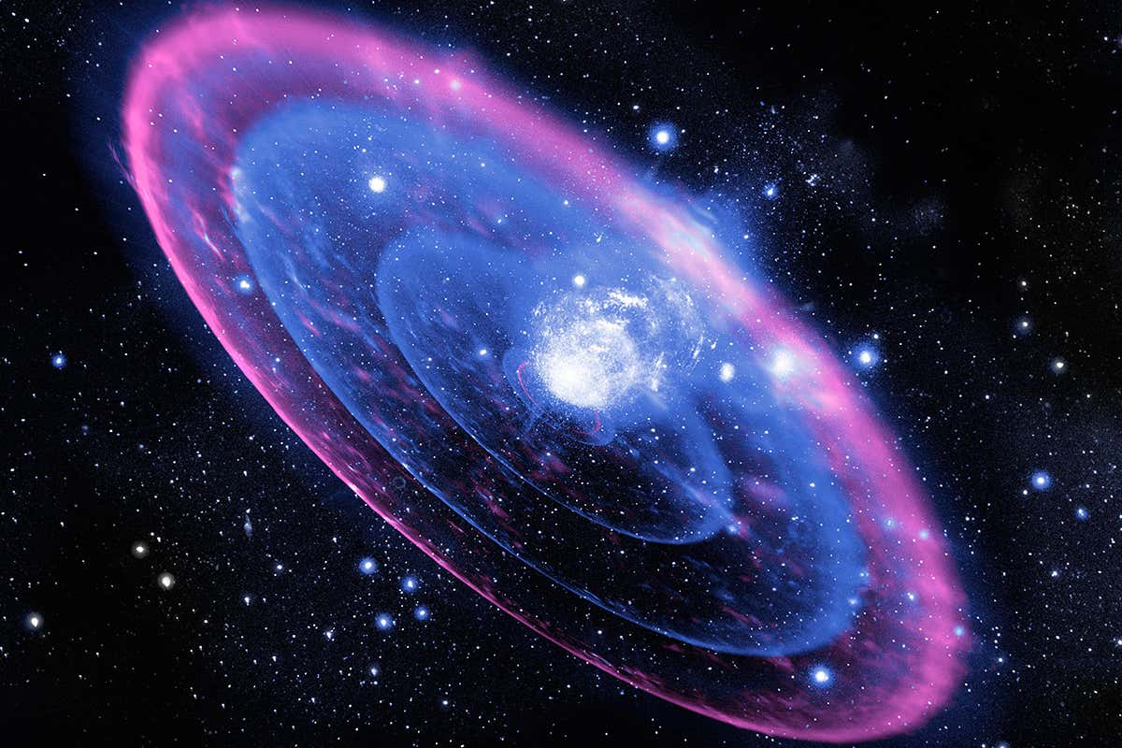
“For in Him dwells all the fullness of the Godhead bodily;
and you are complete in Him, who is the head of all principality and power.

Slide 8
⁹ For in Christ all the fullness of the Deity lives in bodily form, ¹⁰ and in Christ you have been brought to fullness. He is the head over every power and authority. (NIV)

Slide 9
ὅτι ἐν αὐτῶ κατοικεῖ πᾶν τὸ πλήρωμα τῆς θεότητος σωματικῶς.
καὶ ἐστε ἐν αὐτῶ πεπληρωμένοι ὅς ἐστιν ἡ κεφαλὴ πάσης ἀρχῆς καὶ ἐξουσίας.
Holmes, M. W. (2011–2013). The Greek New Testament: SBL Edition (Col 2:9–10). Lexham Press; Society of Biblical Literature.
hoti en auto katoikei pan to pleroma tes Theotetos somatikos.
kai este en auto pepleromenoi hos estin he kephale pases arches kai exousias.

Slide 10
⁹ For in Christ all the fullness of the Deity lives in bodily form, ¹⁰ and in Christ you have been brought to fullness. He is the head over every power and authority. (Colossians 2:9-10 NIV)

Slide 11
“For in Him dwells all the fullness of the Godhead bodily;
and you are complete in Him, who is the head of all principality and power.”
(Colossians 2:9-10)

Slide 12
2 For I want you to know what a great conflict I have for you and those in Laodicea, and* as many as have not seen my face in the flesh, ² that their hearts may be encouraged, being knit together in love, and* to all riches of the full assurance of understanding, to the knowledge of the mystery of God, both of the Father and of Christ, ³ in whom are hidden all the treasures of wisdom and knowledge.
⁴ Now this I say lest anyone should deceive you with persuasive words. ⁵ For though I am absent in the flesh, yet I am with you in spirit, rejoicing to see your order* and the steadfastness of your faith in Christ.
⁶ As you therefore have received Christ Jesus the Lord, so walk in Him, ⁷ rooted and built up in Him and established in the faith, as you have been taught, abounding in it with thanksgiving.

Slide 13
⁸ Beware lest anyone cheat you through philosophy and empty deceit, according to the tradition of men, according to the basic principles of the world, and not according to Christ. ⁹ For in Him dwells all the fullness of the Godhead bodily; ¹⁰ and you are complete in Him, who is the head of all principality and power. 11 In Him you were also circumcised with the circumcision made without hands, by putting off the body of the sins of the flesh, by the circumcision of Christ, 12 buried with Him in baptism, in which you also were raised with Him through faith in the working of God, who raised Him from the dead. (Colossians 2:1-12 NKJ no italicized words)

Slide 14
2 For I want you to know what a great conflict I have for you and those in Laodicea, and* as many as have not seen my face in the flesh, ² that their hearts may be encouraged, being knit together in love, and* to all riches of the full assurance of understanding, to the knowledge of the mystery of God, both of the Father and of Christ, ³ in whom are hidden all the treasures of wisdom and knowledge.
⁴ Now this I say lest anyone should deceive you with persuasive words. ⁵ For though I am absent in the flesh, yet I am with you in spirit, rejoicing to see your order* and the steadfastness of your faith in Christ.
⁶ As you therefore have received Christ Jesus the Lord, so walk in Him, ⁷ rooted and built up in Him and established in the faith, as you have been taught, abounding in it with thanksgiving.

Slide 15
⁸ Beware lest anyone cheat you through philosophy and empty deceit, according to the tradition of men, according to the basic principles of the world, and not according to Christ. ⁹ For in Him dwells all the fullness of the Godhead bodily; ¹⁰ and you are complete in Him, who is the head of all principality and power.
11 In Him you were also circumcised with the circumcision made without hands, by putting off the body of the sins of the flesh, by the circumcision of Christ, 12 buried with Him in baptism, in which you also were raised with Him through faith in the working of God, who raised Him from the dead. (Colossians 2:1-12 NKJ no italicized words)

Slide 16
¹⁵ Therefore I also, after I heard of your faith in the Lord Jesus and your love for all the saints, ¹⁶ do not cease to give thanks for you, making mention of you in my prayers: ¹⁷ that the God of our Lord Jesus Christ, the Father of glory, may give to you the spirit of wisdom and revelation in the knowledge of Him, ¹⁸ the eyes of your understanding being enlightened; that you may know what is the hope of His calling, what are the riches of the glory of His inheritance in the saints, ¹⁹ and what is the exceeding greatness of His power toward us who believe, according to the working of His mighty power ²⁰ which He worked in Christ when He raised Him from the dead and seated Him at His right hand in the heavenly places, ²¹ far above all principality and power and might and dominion, and every name that is named, not only in this age but also in that which is to come.
²² And He put all things under His feet, and gave Him to be head over all things to the church, ²³ which is His body, the fullness of Him who fills all in all. (Ephesians 1:15-23 NKJ)

Slide 17
“For in Him dwells all the fullness of the Godhead bodily;
and you are complete in Him, who is the head of all principality and power.

