Slide 1

Colossians

Slide 2
Colossians
Colossians Series Outline
Sept. 8 - Intro – 1:1-12
Oct. 13 – Chapter 1:13 - 29
Nov. 10 – Chapter 2:1-12
Dec. 8 – Chapter 2:13-23
2020
Jan. 12 – Chapter 3:1-17
Feb. 9 – Chapter 3:18-25
Mar. 8 – Chapter 4:1-9
Apr. 12 – Chapter 4:10-18

Slide 3
Colossians
Colossians Series Outline
Sept. 8 - Intro – 1:1-12
Oct. 13 – Chapter 1:13 - 29
Nov. 10 – Chapter 2:1-12
Dec. 8 – Chapter 2:13-23
2020
Jan. 12 – Chapter 3:1-17
Feb. 9 – Chapter 3:18-25
Mar. 8 – Chapter 4:1-9
Apr. 12 – Chapter 4:10-18
The Excellence and Supremacy of Messiah

Slide 4
Colossians
Colossians Series Outline
Sept. 8 - Intro – 1:1-14
Oct. 13 – Chapter 1:15 - 29
Nov. 10 – Chapter 2:1-12
Dec. 8 – Chapter 2:13-23
2020
Jan. 12 – Chapter 3:1-17
Feb. 9 – Chapter 3:18-25
Mar. 8 – Chapter 4:1-9
Apr. 12 – Chapter 4:10-18
The Excellence and Supremacy of Messiah
The Preeminence and sufficiency of Christ in all things.

Slide 5
It is all about Jesus!!

Slide 6
Key Verse 2:9-10
“For in Him dwells all the fullness of the Godhead bodily; and you are complete in Him, who is the head of all principality and power.

Slide 7
Key Verse 2:8-10 (some more context)
“8 Beware lest anyone cheat you through philosophy and empty deceit, according to the tradition of men, according to the basic principles of the world, and not according to Christ. 9 For in Him dwells all the fullness of the Godhead bodily; 10 and you are complete in Him, who is the head of all principality and power.

Slide 8

False Teachings vs. The Centrality of Messiah

Slide 9
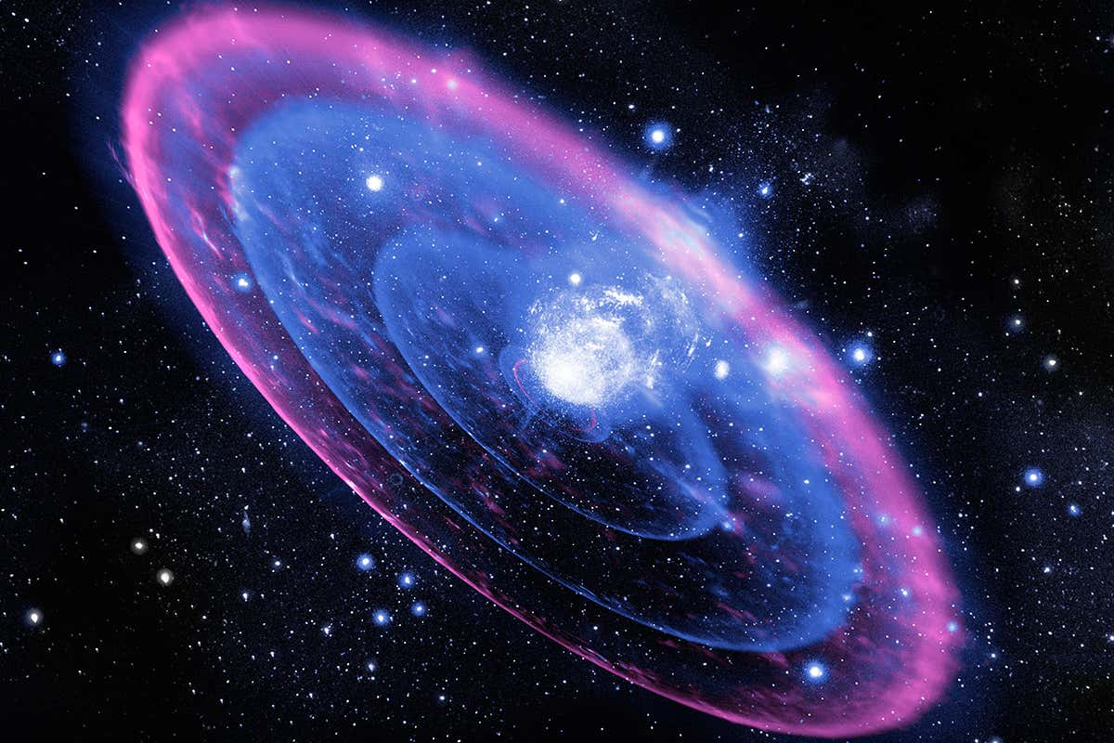
“For in Him dwells all the fullness of the Godhead bodily;
and you are complete in Him, who is the head of all principality and power.

Slide 10
The Excellence and Supremacy of Messiah

Slide 11
13 He has delivered us from the power of darkness and conveyed us into the kingdom of the Son of His love, 14 in whom we have redemption through His blood, the forgiveness of sins.

Slide 12
15 He is the image of the invisible God, the firstborn over all creation. 16 For by Him all things were created that are in heaven and that are on earth, visible and invisible, whether thrones or dominions or principalities or powers. All things were created through Him and for Him. 17 And He is before all things, and in Him all things consist. 18 And He is the head of the body, the church, who is the beginning, the firstborn from the dead, that in all things He may have the preeminence. 19 For it pleased the Father that in Him all the fullness should dwell, 20 and by Him to reconcile all things to Himself, by Him, whether things on earth or things in heaven, having made peace through the blood of His cross.

Slide 13
21 And you, who once were alienated and enemies in your mind by wicked works, yet now He has reconciled 22 in the body of His flesh through death, to present you holy, and blameless, and above reproach in His sight—23 if indeed you continue in the faith, grounded and steadfast, and are not moved away from the hope of the gospel which you heard, which was preached to every creature under heaven, of which I, Paul, became a minister.

Slide 14
24 I now rejoice in my sufferings for you, and fill up in my flesh what is lacking in the afflictions of Christ, for the sake of His body, which is the church, 25 of which I became a minister according to the stewardship from God which was given to me for you, to fulfill the word of God, 26 the mystery which has been hidden from ages and from generations, but now has been revealed to His saints. 27 To them God willed to make known what are the riches of the glory of this mystery among the Gentiles: which is Christ in you, the hope of glory. 28 Him we preach, warning every man and teaching every man in all wisdom, that we may present every man perfect in Christ Jesus. 29 To this end I also labor, striving according to His working which works in me mightily.

Slide 15
into the kingdom of the Son of His love, 14 in whom we have redemption through His blood, the forgiveness of sins.
15 He is the image of the invisible God, the firstborn over all creation. 16 For by Him all things were created that are in heaven and that are on earth, visible and invisible, whether thrones or dominions or principalities or powers. All things were created through Him and for Him. 17 And He is before all things, and in Him all things consist. 18 And He is the head of the body, the church, who is the beginning, the firstborn from the dead, that in all things He may have the preeminence. 19 For it pleased the Father that in Him all the fullness should dwell, 20 and by Him to reconcile all things to Himself, by Him, whether things on earth or things in heaven, having made peace through the blood of His cross.

Slide 16
into the kingdom of the Son of His love, 14 in whom we have redemption through His blood, the forgiveness of sins.
15 He is the image of the invisible God, the firstborn over all creation. 16 For by Him all things were created that are in heaven and that are on earth, visible and invisible, whether thrones or dominions or principalities or powers. All things were created through Him and for Him. 17 And He is before all things, and in Him all things consist. 18 And He is the head of the body, the church, who is the beginning, the firstborn from the dead, that in all things He may have the preeminence. 19 For it pleased the Father that in Him all the fullness should dwell, 20 and by Him to reconcile all things to Himself, by Him, whether things on earth or things in heaven, having made peace through the blood of His cross.

Slide 17
He is image of invisible God
He is the firstborn over all creation
By Him all things were created in heaven and on earth.
Visible and invisible things created by Him
Whether thrones, dominions, principalities or powers.
All things were created though Him and for Him.
He is before all things, and in His all things consist.
He is the head of the body – the church.
He is the beginning, the firstborn from the dead.
The one that in all things has preeminence.
In Him all fulness dwells.
By Him all things reconcile
on earth or in heaven….having made peace through His blood.

Slide 18
He is image of invisible God
He is the firstborn over all creation
By Him all things were created in heaven and on earth.
Visible and invisible things created by Him
Whether thrones, dominions, principalities or powers.
All things were created though Him and for Him.
He is before all things, and in His all things consist.
He is the head of the body – the community of faith.
He is the beginning, the firstborn from the dead.
The one that in all things has preeminence.
In Him all fulness dwells.
By Him all things reconcile
on earth or in heaven….having made peace through His blood.

Slide 19
21 And you, who once were alienated and enemies in your mind by wicked works, yet now He has reconciled 22 in the body of His flesh through death, to present you holy, and blameless, and above reproach in His sight—23 if indeed you continue in the faith, grounded and steadfast, and are not moved away from the hope of the gospel which you heard, which was preached to every creature under heaven, of which I, Paul, became a minister.

Slide 20
24 I now rejoice in my sufferings for you, and fill up in my flesh what is lacking in the afflictions of Christ, for the sake of His body, which is the church, 25 of which I became a minister according to the stewardship from God which was given to me for you, to fulfill the word of God, 26 the mystery which has been hidden from ages and from generations, but now has been revealed to His saints. 27 To them God willed to make known what are the riches of the glory of this mystery among the Gentiles: which is Christ in you, the hope of glory. 28 Him we preach, warning every man and teaching every man in all wisdom, that we may present every man perfect in Christ Jesus. 29 To this end I also labor, striving according to His working which works in me mightily.

Slide 21
21 And you, who once were alienated and enemies in your mind by wicked works, yet now He has reconciled 22 in the body of His flesh through death, to present you holy, and blameless, and above reproach in His sight—23 if indeed you continue in the faith, grounded and steadfast, and are not moved away from the hope of the gospel which you heard, which was preached to every creature under heaven, of which I, Paul, became a minister.

Slide 22
24 I now rejoice in my sufferings for you, and fill up in my flesh what is lacking in the afflictions of Christ, for the sake of His body, which is the church, 25 of which I became a minister according to the stewardship from God which was given to me for you, to fulfill the word of God, 26 the mystery which has been hidden from ages and from generations, but now has been revealed to His saints. 27 To them God willed to make known what are the riches of the glory of this mystery among the Gentiles: which is Christ in you, the hope of glory. 28 Him we preach, warning every man and teaching every man in all wisdom, that we may present every man perfect in Christ Jesus. 29 To this end I also labor, striving according to His working which works in me mightily.

Slide 23
You were alienated
You were enemies in your mind by wicked works
Now you are reconciled
To present you holy
If indeed you continue in the faith
The hope of the gospel which you heard.
Paul’s suffering for you,
Grace given Paul for you.
Mystery among the Gentiles: Christ in YOU, the hope of glory!

Slide 24
into the kingdom of the Son of His love, 14 in whom we have redemption through His blood, the forgiveness of sins.
You were alienated
You were enemies in your mind by wicked works
Now you are reconciled
To present you holy
If indeed you continue in the faith.
The hope of the gospel which you heard.
Paul’s suffering for you,
Grace given Paul for you.
Mystery among the Gentiles: Christ in YOU, the hope of glory!

Slide 25
into the kingdom of the Son of His love, 14 in whom we have redemption through His blood, the forgiveness of sins.
He is image of invisible God
He is the firstborn over all creation
By Him all things were created
  in heaven and on earth.
Visible and invisible things created by Him
thrones, dominions, principalities or powers.
All things were created though Him and for Him.
He is before all things, and in His all things consist.
He is the head of the body – the community of faith.
He is the beginning, the firstborn from the dead.
The one that in all things has preeminence.
In Him all fulness dwells.
By Him all things reconcile
on earth or in heaven….
  having made peace through His blood.
You were alienated
You enemies in your mind by wicked works
Now you are reconciled
To present you holy
If indeed you continue in the faith.
The hope of the gospel which you heard.
Paul’s suffering for you,
Grace given Paul for you.
Mystery among the Gentiles:
  Christ in YOU, the hope of glory!

Slide 26
Key Verse 2:9-10
“For in Him dwells all the fullness of the Godhead bodily; and you are complete in Him, who is the head of all principality and power.

