Slide 1

Colossians

Slide 2
Colossians
Colossians Series Outline
Sept. 8 - Intro – 1:1-12
Oct. 13 – Chapter 1:13 - 29
Nov. 10 – Chapter 2:1-12
Dec. 8 – Chapter 2:13-23
2020
Jan. 12 – Chapter 3:1-17
Feb. 9 – Chapter 3:18-25
Mar. 8 – Chapter 4:1-9
Apr. 12 – Chapter 4:10-18

Slide 3
Colossians
Colossians Series Outline
Sept. 8 - Intro – 1:1-12
Oct. 13 – Chapter 1:13 - 29
Nov. 10 – Chapter 2:1-12
Dec. 8 – Chapter 2:13-23
2020
Jan. 12 – Chapter 3:1-17
Feb. 9 – Chapter 3:18-25
Mar. 8 – Chapter 4:1-9
Apr. 12 – Chapter 4:10-18
The Excellence and Supremacy of Messiah

Slide 4
Colossians
Colossians Series Outline
Sept. 8 - Intro – 1:1-14
Oct. 13 – Chapter 1:15 - 29
Nov. 10 – Chapter 2:1-12
Dec. 8 – Chapter 2:13-23
2020
Jan. 12 – Chapter 3:1-17
Feb. 9 – Chapter 3:18-25
Mar. 8 – Chapter 4:1-9
Apr. 12 – Chapter 4:10-18
The Excellence and Supremacy of Messiah
The Preeminence and sufficiency of Christ in all things.

Slide 5
It is all about Jesus!!

Slide 6
ישוע המשיח
Jesus the Messiah of Israel

Slide 7
ישוע המשיח
Jesus the Messiah of Israel

Slide 8
ישוע המשיח
Jesus the Messiah of Israel
Jesus the Anointed One
of Israel

Slide 9
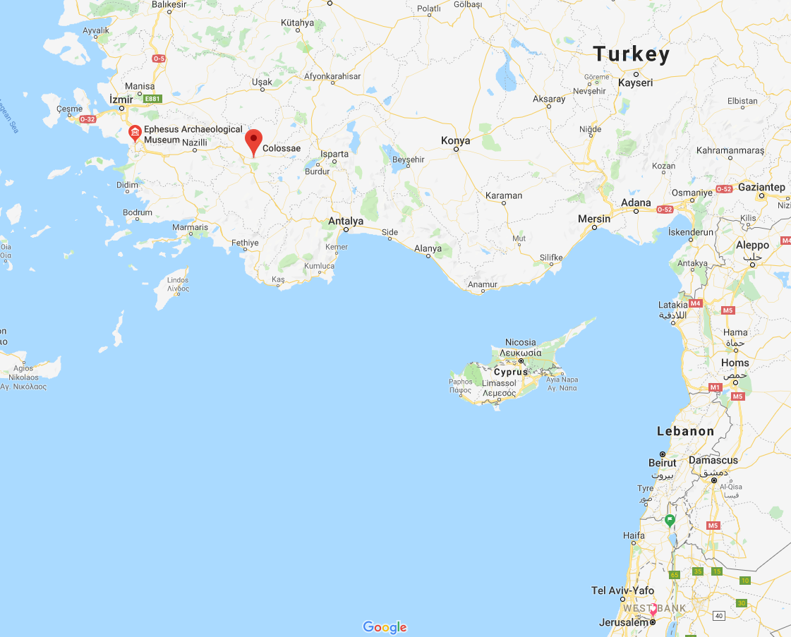

Slide 10
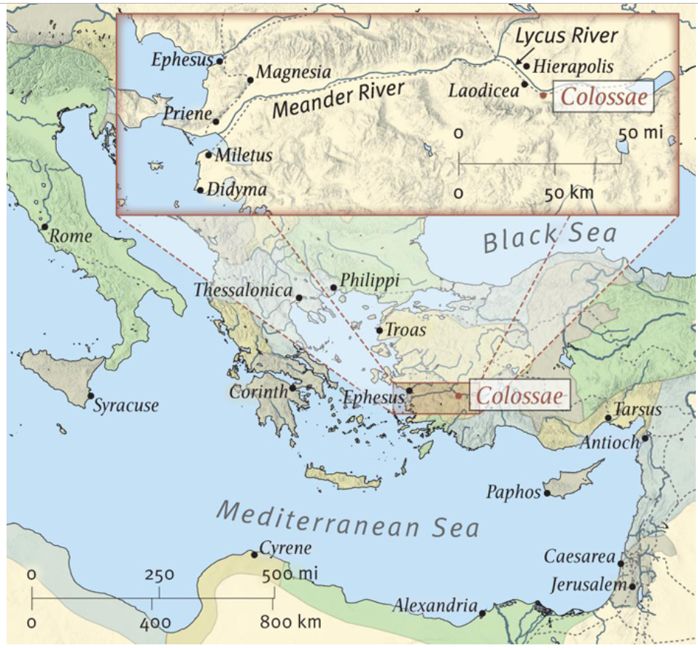

Slide 11
Key Verse 2:9-10
“For in Him dwells all the fullness of the Godhead bodily; and you are complete in Him, who is the head of all principality and power.

Slide 12
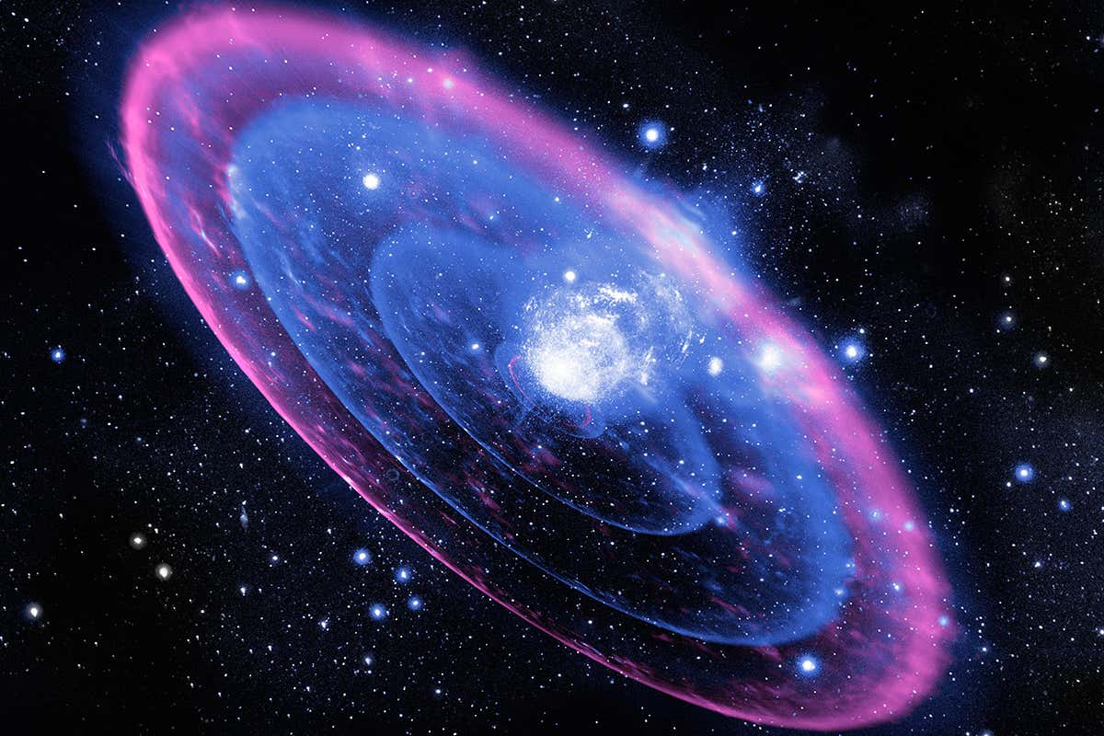
“For in Him dwells all the fullness of the Godhead bodily;
and you are complete in Him, who is the head of all principality and power.

Slide 13
Key Verse 2:8-10 (some more context)
“8 Beware lest anyone cheat you through philosophy and empty deceit, according to the tradition of men, according to the basic principles of the world, and not according to Christ. 9 For in Him dwells all the fullness of the Godhead bodily; 10 and you are complete in Him, who is the head of all principality and power.

Slide 14
Vs. False Teachings within the Body
• Ceremonialism – rules about food, drink, celebrations.
2:16-17, 2:11, 3:11
• Asceticism – Do not handle, do not taste, do not touch!
2:21, 2:23
• Angel Worship – 2:18
• Depreciation of Christ - 1:15-20, 2:2-3:9
• Secret Knowledge – 2:18, 2:2-3
• Reliance on human wisdom and tradition 2:4,8

Slide 15

False Teachings vs. The Centrality of Messiah

Slide 16
“For in Him dwells all the fullness of the Godhead bodily;
and you are complete in Him, who is the head of all principality and power.

Slide 17
The Excellence and Supremacy of Messiah

Slide 18
Paul, an apostle of Jesus Christ by the will of God, and Timothy our brother, To the saints and faithful brethren in Christ who are in Colosse: Grace to you and peace from God our Father and the Lord Jesus Christ. 3 We give thanks to the God and Father of our Lord Jesus Christ, praying always for you, 4 since we heard of your faith in Christ Jesus and of your love for all the saints; 5 because of the hope which is laid up for you in heaven, of which you heard before in the word of the truth of the gospel, 6 which has come to you, as it has also in all the world, and is bringing forth fruit, as it is also among you since the day you heard and knew the grace of God in truth; 7 as you also learned from Epaphras, our dear fellow servant, who is a faithful minister of Christ on your behalf, 8 who also declared to us your love in the Spirit.

Slide 19
9 For this reason we also, since the day we heard it, do not cease to pray for you, and to ask that you may be filled with the knowledge of His will in all wisdom and spiritual understanding; 10 that you may walk worthy of the Lord, fully pleasing Him, being fruitful in every good work and increasing in the knowledge of God; 11 strengthened with all might, according to His glorious power, for all patience and longsuffering with joy; 12 giving thanks to the Father who has qualified us to be partakers of the inheritance of the saints in the light. 13 He has delivered us from the power of darkness and conveyed us into the kingdom of the Son of His love, 14 in whom we have redemption through His blood, the forgiveness of sins.

Slide 20
3 We give thanks to the God and Father of our Lord Jesus Christ, praying always for you, 4 since we heard of your faith in Christ Jesus and of your love for all the saints; 5 because of the hope which is laid up for you in heaven, of which you heard before in the word of the truth of the gospel, 6 which has come to you, as it has also in all the world, and is bringing forth fruit, as it is also among you since the day you heard and knew the grace of God in truth; 7 as you also learned from Epaphras, our dear fellow servant, who is a faithful minister of Christ on your behalf, 8 who also declared to us your love in the Spirit.

Slide 21
9 For this reason we also, since the day we heard it, do not cease to pray for you, and to ask that you may be filled with the knowledge of His will in all wisdom and spiritual understanding; 10 that you may walk worthy of the Lord, fully pleasing Him, being fruitful in every good work and increasing in the knowledge of God; 11 strengthened with all might, according to His glorious power, for all patience and longsuffering with joy; 12 giving thanks to the Father who has qualified us to be partakers of the inheritance of the saints in the light.

Slide 22
13 He has delivered us from the power of darkness and conveyed us into the kingdom of the Son of His love, 14 in whom we have redemption through His blood, the forgiveness of sins.

Slide 23
“In whom we have redemption”

Slide 24
“In ___________ we have redemption”

Slide 25
“In ___________
we have redemption”

Slide 26
“In ___________
we have redemption”
The Excellence and Supremacy of Messiah

Slide 27
“In ___________
we have redemption through His blood, the forgiveness of sins.”
The Excellence and Supremacy of Messiah

Slide 28
“In ___________
we have redemption through His blood, the forgiveness of sins.”
The Excellence and Supremacy of Messiah

