Slide 1
Genesis
בראשית
Book of Beginnings

Slide 2
Purpose of Scripture
29 Jesus said to him, “Thomas, because you have seen Me, you have believed. Blessed are those who have not seen and yet have believed.”
30 And truly Jesus did many other signs in the presence of His disciples, which are not written in this book; 31 but these are written that you may believe that Jesus is the Christ, the Son of God, and that believing you may have life in His name.

Slide 3
Five Biblical Understandings/Challenges in study of Genesis (and all scriptures)
1) The Fall Inverted our understanding of the image and character of God.
2) Purpose of Scripture – John 20:31
3) Scriptures hint at a “before”. Titus 1:2, Rev. 13:8, Isa. 14:12-23, Ezek. 28:11-19
4)The Lamb slain/the cross is promised and part of the nature of God from the “before”
5) The Cross/New Covenant is the supreme revelation of God given to man.
Possibly to all of creation – look at all scripture in the light of the
New Covenant.

Slide 4
Progression of Healthy Understanding

Slide 5
Progression of Healthy Understanding
My thinking might be suspect.

Slide 6
Progression of Healthy Understanding
My thinking might be suspect.
My thinking is likely to be suspect.

Slide 7
Progression of Healthy Understanding
My thinking might be suspect.
My thinking is likely to be suspect.
My thinking is always suspect!

Slide 8
בְּרֵאשִׁ֖ית בָּרָ֣א אֱלֹהִ֑ים אֵ֥ת הַשָּׁמַ֖יִם וְאֵ֥ת הָאָֽרֶץ:
בראשית ברא אלהים את השמים ואת הארץ׃

Slide 9
בְּרֵאשִׁ֖ית בָּרָ֣א אֱלֹהִ֑ים אֵ֥ת הַשָּׁמַ֖יִם וְאֵ֥ת הָאָֽרֶץ:
בראשית ברא אלהים את השמים ואת הארץ׃
ha’áretz ve’ét hashamáyim et Elohím bará Beresheet.

Slide 10
Genesis 1:2
והָאְָ֗רֶץ הָיְתָ֥ה תֹ֙הוּ֙ וָבֹ֔הוּ וְחֹ֖שֶׁךְ עַל־ פְּנֵ֣י תְה֑וֹם וְר֣וּחַ אֱלֹהִ֔ים מְרַחֶ֖פֶת עַל־ פְּנֵ֥י הַמָּֽיִם׃

Slide 11
Genesis 1:2
וְהָאָ֗רֶץ הָיְתָ֥ה תֹ֙הוּ֙ וָבֹ֔הוּ וְחֹ֖שֶׁךְ עַל־ פְּנֵ֣י תְה֑וֹם
deep face on/upon darkness& void/ &desolation& was/had earth

Slide 12
Genesis 1:2
וְהָאָ֗רֶץ הָיְתָ֥ה תֹ֙הוּ֙ וָבֹ֔הוּ וְחֹ֖שֶׁךְ עַל־ פְּנֵ֣י תְה֑וֹם
deep face on/upon darkness& void/ &desolation& was/had earth
Other Verses with תהו
Deuteronomy 32:10, Isaiah 24:10, Isaiah 29:21, Isaiah 34:11, Isaiah 41:29, Isaiah 44:9, Job 12:24, Job 26:7

Slide 13
Genesis 1:2
וְהָאָ֗רֶץ הָיְתָ֥ה תֹ֙הוּ֙ וָבֹ֔הוּ וְחֹ֖שֶׁךְ עַל־ פְּנֵ֣י תְה֑וֹם
deep face on/upon darkness& void/ &desolation& was/had earth
By and large, therefore, I suggest that the rendering,
“But the earth had become a “ruin and desolation” is a rendering which does more justice to the original and deserves more serious consideration as an alternative than it has been customary to afford it in recent years.”
Without Form and Void by Arthur C. Custance

Slide 14
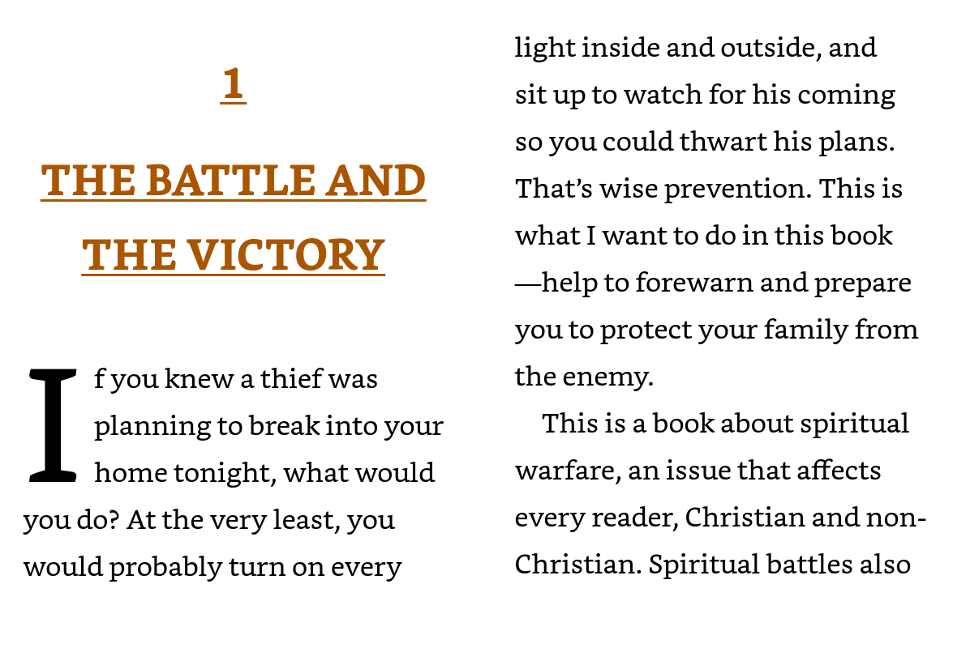

Slide 15
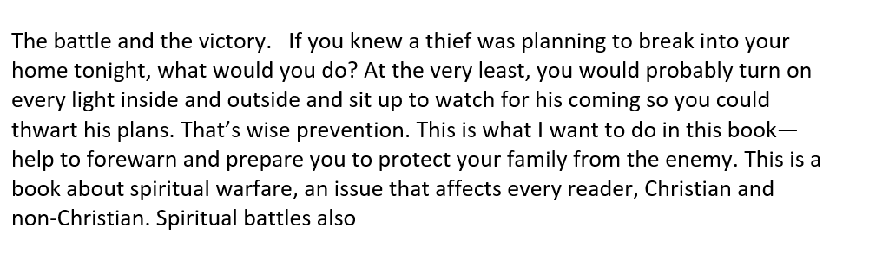

Slide 16
1 In the beginning God created the heavens and the earth. 2 The earth was without form, and void; and darkness was on the face of the deep. And the Spirit of God was hovering over the face of the waters.
3 Then God said, “Let there be light”; and there was light. 4 And God saw the light, that it was good; and God divided the light from the darkness. 5 God called the light Day, and the darkness He called Night. So the evening and the morning were the first day.

Slide 17
In the beginning God created the heavens and the earth. The earth had become a ruin and desolation; ; and darkness was on the face of the deep. And the Spirit of God was hovering over the face of the waters.
Then God said, “Let there be light”; and there was light. And God saw the light, that it was good; and God divided the light from the darkness. God called the light Day, and the darkness He called Night. So the evening and the morning were the first day.

Slide 18
In the beginning God created the heavens and the earth
The earth had become a ruin and desolation; and darkness was on the face of the deep. And the Spirit of God was hovering over the face of the waters.
Then God said, “Let there be light”; and there was light. And God saw the light, that it was good; and God divided the light from the darkness. God called the light Day, and the darkness He called Night. So the evening and the morning were the first day.

